Slide 1


Designing and Implementing a simple 16-bit CPU
Final Presentation
Don Stayner
December 2014

Slide 2
Recap
Opportunity to understand inner workings of a basic CPU
Take advantage of hardware programming experience at Dartmouth
Natural extension of Electronics & Computers course

Slide 3
A Slide From September: Goals of the Project
Implement a 16-bit CPU that can:
Speak to RAM
Process assembly language
Run simple programs
Ensure design is easy to understand and well-suited to an academic environment
Document process
Develop understanding of CPU and microprocessor design
Well, how did I do?

Slide 4
Defining the CPU
The CPU is an integrated circuit that executes instructions written in its machine language.
The CPU must be Turing Complete – able to compute anything that is computable (given appropriate algorithm, time and memory)
To be Turing Complete, the CPU must support some form of data movement and conditional branching
This is why calculators aren’t considered CPUs
Notes:
To show that something is Turing complete, it is enough to show that it can be used to simulate the most primitive computer, since even the simplest computer can be used to simulate the most complicated one.

Slide 5
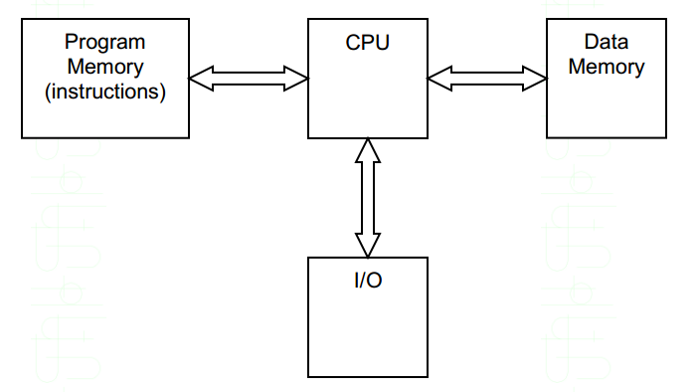
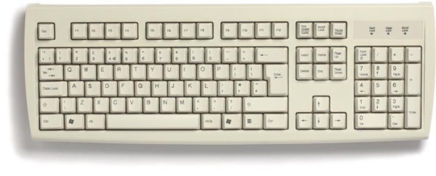

Basic CPU Overview
Carries out the instructions of a computer program
Performs basic arithmetical, logical and I/O operations of the system
© Washington State University

Slide 6
Basic CPU Overview
1. Program instructions written to read-only memory in machine language (0’s and 1’s)
© Washington State University
Notes:
Revamp this slide: Program instructions, execute, write output to data memory, communicate to user via I/O

Slide 7
Basic CPU Overview
2. Processing: The CPU executes instructions from Program Memory and writes output to Data Memory
© Washington State University
Notes:
The task of performing operations like arithmetic and logical operations is called processing. The Central Processing Unit (CPU) takes data and instructions from the storage unit and makes all sorts of calculations based on the instructions given and the type of data provided. It is then sent back to the storage unit.

Slide 8
Basic CPU Overview
3. Program results served back to user via I/O
© Washington State University
Notes:
The task of performing operations like arithmetic and logical operations is called processing. The Central Processing Unit (CPU) takes data and instructions from the storage unit and makes all sorts of calculations based on the instructions given and the type of data provided. It is then sent back to the storage unit.

Slide 9
Communicating with CPU: High-Level Languages
One Statement
Multiple Lines of Assembly
Compiler
High-Level Languages
Machine Language
CPU
Notes:
A central processing unit (CPU) is the hardware within a computer that carries out the instructions of a computer program by performing the basic arithmetical, logical, and input/output operations of the system
Talk about why it is useful to operate at the level of assembly and machine language – in the industry – why do people use machine language if they can write things in Java, Python, Fortran, etc?
Useful because it allows us to address edge cases and make things more efficient
Engineers do work at the level of assembly! Talk about this and justify.
Machine language:
-

Slide 10
Communicating with CPU: Assembly
Assembly Language represents the human-readable form of machine code. Each assembly line corresponds to one CPU instruction in machine language
Assembly Language
Assembler
Machine Language
One Statement
One binary machine instruction
CPU
Notes:
A central processing unit (CPU) is the hardware within a computer that carries out the instructions of a computer program by performing the basic arithmetical, logical, and input/output operations of the system
Talk about why it is useful to operate at the level of assembly and machine language – in the industry – why do people use machine language if they can write things in Java, Python, Fortran, etc?
Useful because it allows us to address edge cases and make things more efficient
Engineers do work at the level of assembly! Talk about this and justify.
Machine language:
-

Slide 11
Design Phase
Define Instruction Set in Assembly
Design Datapath
Arithmetic Logic Unit (ALU)
Registers
RAM storage
Design Program Counter
Define Instruction Set Architecture
Design Instruction Decoder

Slide 12
Overview of Results
Supported Instruction Set
Instruction Set Architecture
Overview of decoding process
Circuit Diagram: Understand how signals are routed for simple examples.

Slide 13







Supported Instruction Set Architecture (ISA)

Slide 14
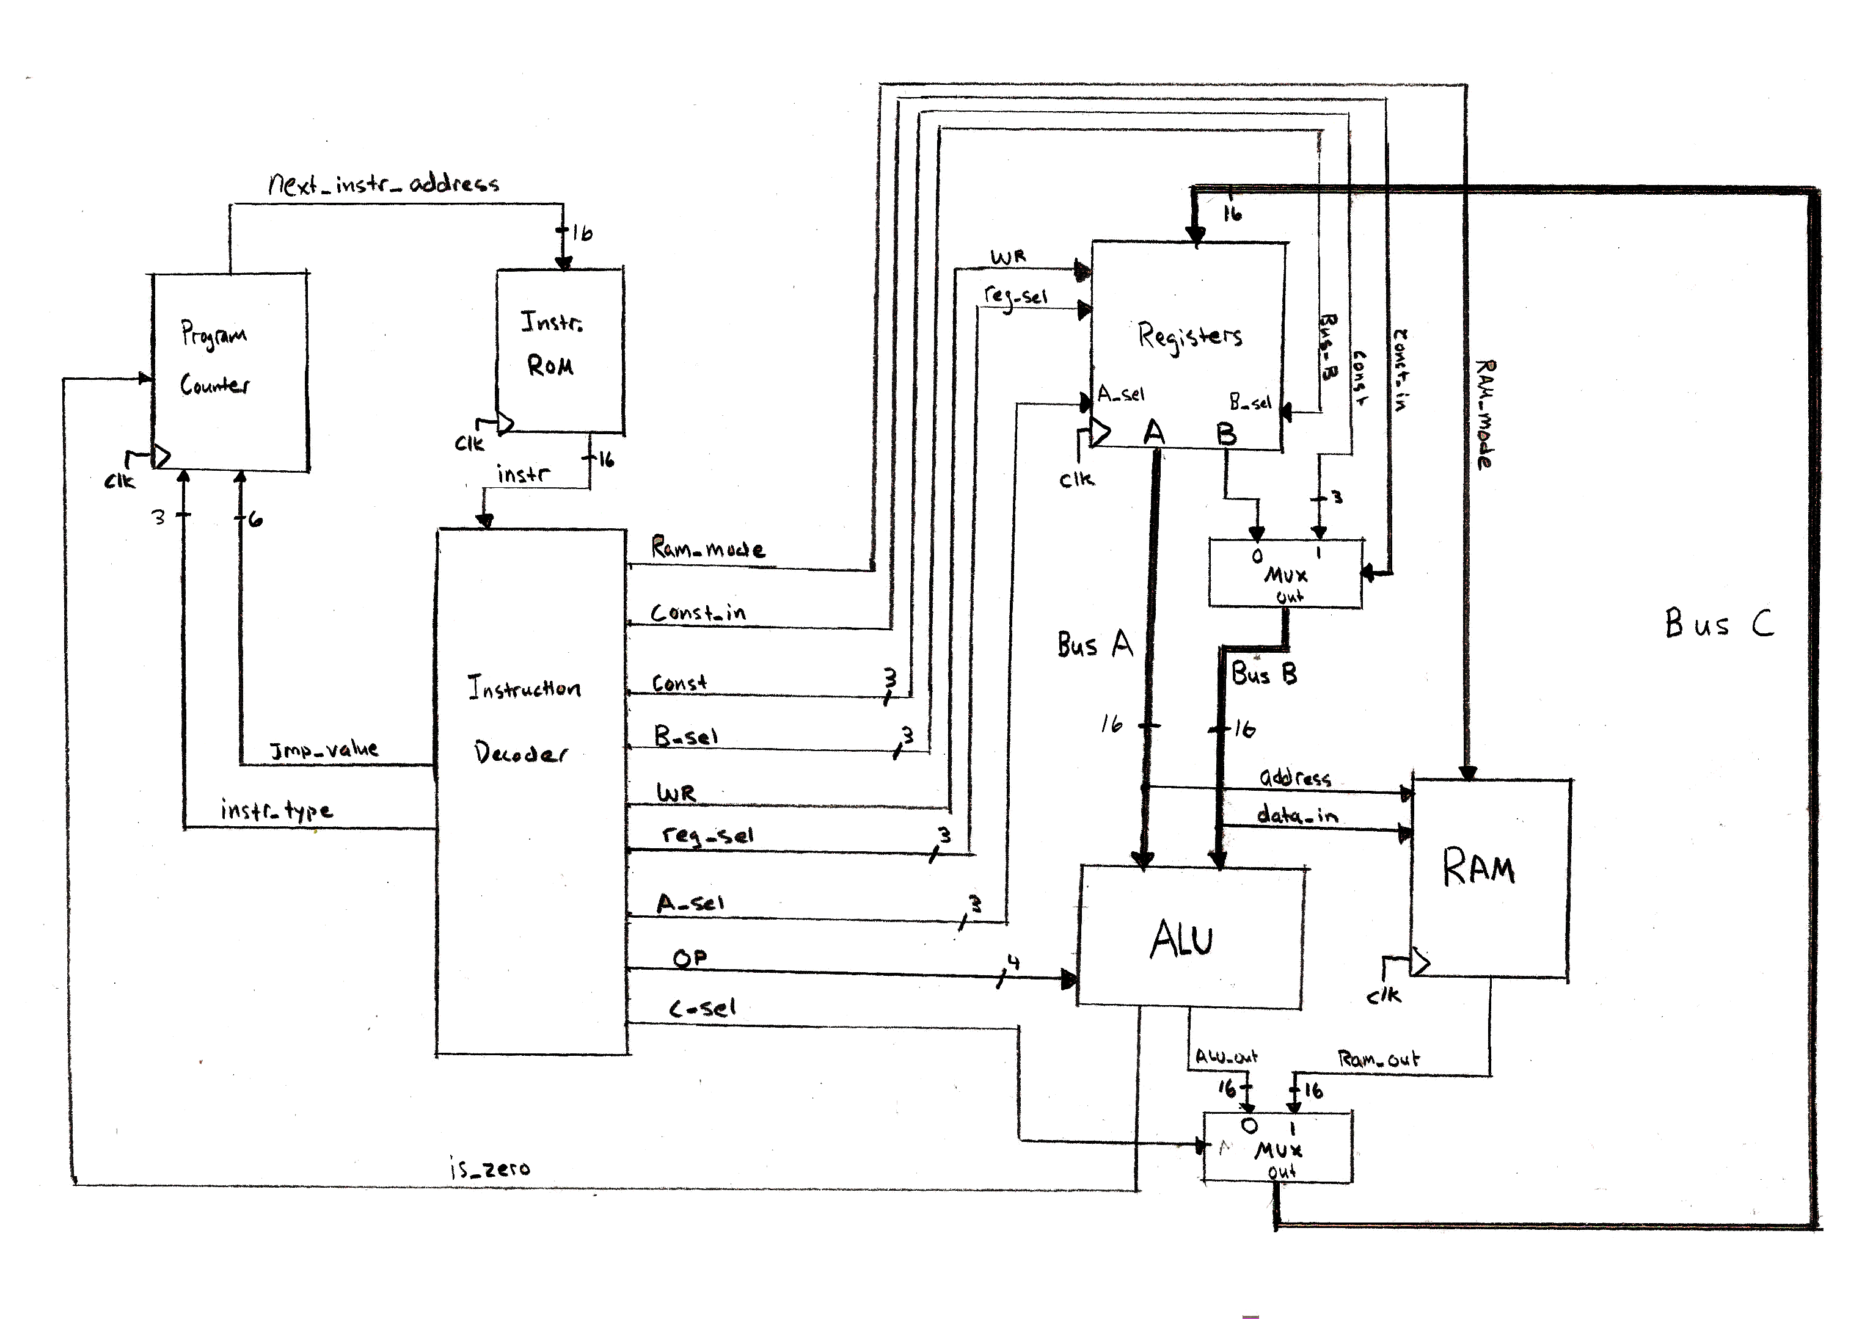
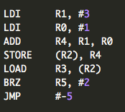
Full Circuit Diagram
* We assume instruction ROM has already been programmed for simplicity
Now let’s run through some quick examples…

Slide 15
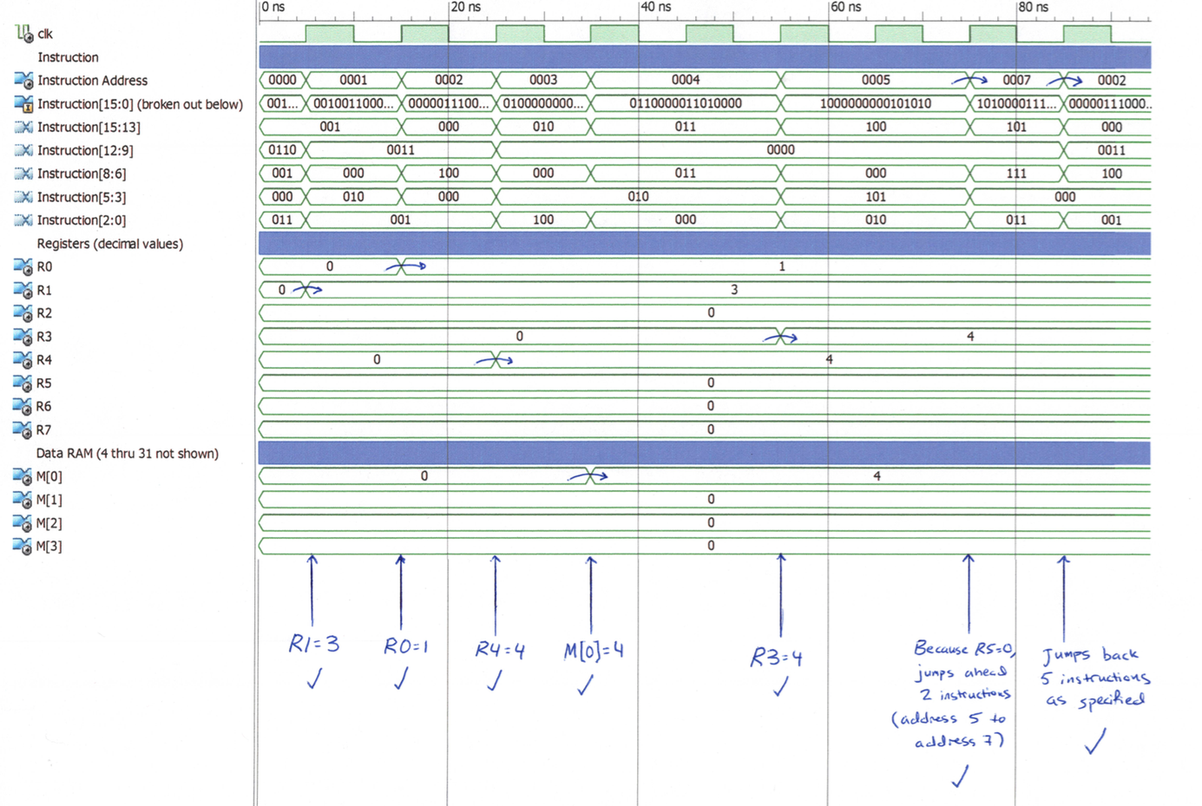
Simulated Testbench of CPU

Slide 16
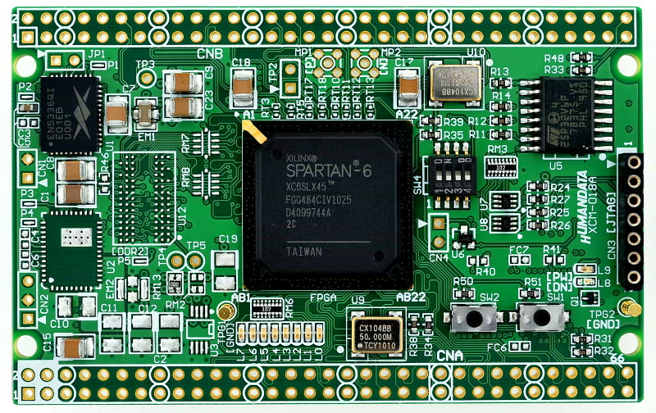
Programming VHDL to Hardware
Each component of the CPU was first described behaviorally and subsequently coded in VHDL
The hardware: a “reprogrammable” integrated circuit that functions as a code-controlled breadboard
Nexys 3 Spartan-6 FPGA Board

Slide 17
Current Design Status
Verified working with a pre-programmed instruction ROM!!
In other words, the CPU I have designed actually works. From this point on, it’s all about adding features.
There are many next steps for this project.
Currently working on a boot loader that loads programs via USB or serial port (in progress, unfortunately not ready for demo)
Once boot loader in place, I would build out the CPU’s I/O capabilities – adding “interrupt” support and connecting a monitor and keyboard
Writing a python script to act as an assembler for the ISA

Slide 18
Presentation References
http://www.wallconvert.com/wallpapers/computers/cpu-wafers-4900.html
CPU Wafer Photo

Slide 19
Instruction Decoder Logic
Instruction Type |  | Resulting signals to route
Description | Opcode bits 15-13 | Reg_sel | A_sel | B_sel | C_sel | WR | const | const_in | ram_mode
Register ALU | 000 | dest reg | src reg 1 | src reg 2 | 0 | 1 | xxx | 0 | 0
Const operand ALU | 100 | dest reg | src reg 1 | xxx | 0 | 1 | Operand | 1 | 0
Memory Write | 010 | xxx | RAM addr | input reg | 1 | 1 | xxx | 0 | 0
Memory Read | 011 | output reg | RAM addr | xxx | x | 0 | xxx | 0 | 1
Instruction Type |  | Resulting signals to route
Description | Opcode bits 15-13 | jmp_value | instr_type
Register ALU | 110 | address bits 5-3 & 2-0 | 100
Constant Operand ALU | 111 | address bits 5-3 & 2-0 | 101

Slide 20
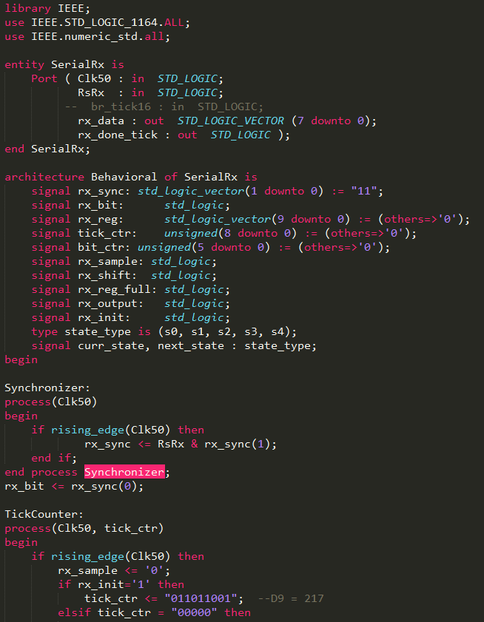
Design Tool: VHDL
VHDL is a hardware description language for developing integrated circuits
Before VHDL, circuits were designed using schematics
Industry standard for digital electronics
Ex: Intel, Qualcomm, BAE, NASA, SpaceX

Slide 21
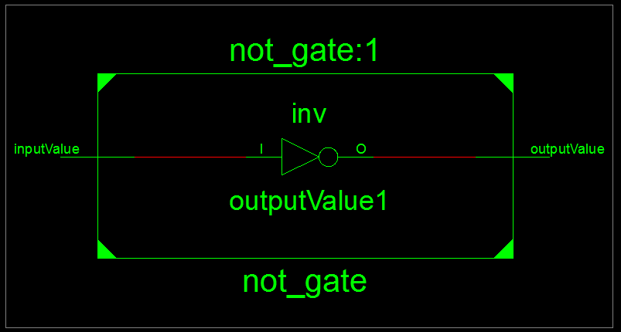
VHDL: Coding a NOT gate
Input
Output
Equivalent Truth Table
inputValue | outputValue
A | B = NOT A
0 | 1
1 | 0

Slide 22
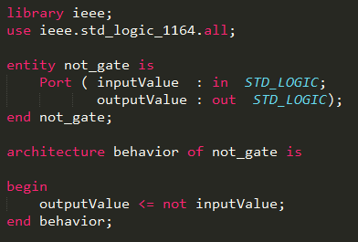

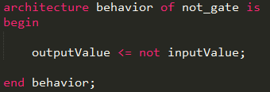
VHDL: Coding a NOT gate
Step 1: Define Entity
Input ports
Output ports
Step 2: Define Behavior
Output “gets” NOT input
Full VHDL code for NOT logic gate

Slide 23

VHDL: Coding a NOT gate
Step 3: Test Design
Vary input and observe output for desired behavior
** Observe: output is negation of input

